Slide 1
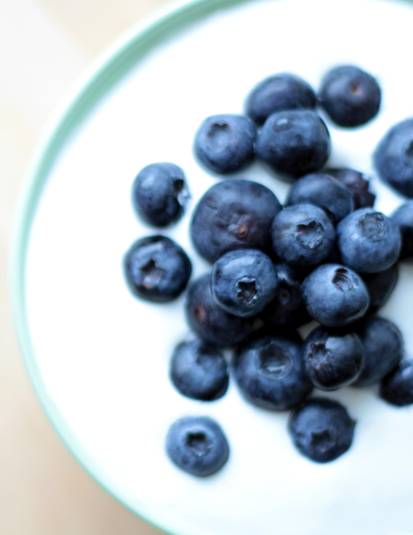

Yogurt and Yogurt Drinks
US, August 2017

Slide 2
The Issues
Spoonable yogurt declines
Newer yogurt segments and flavors have a lower perception of health
Purchase often based on habit
Added sugars remain a concern

Slide 3
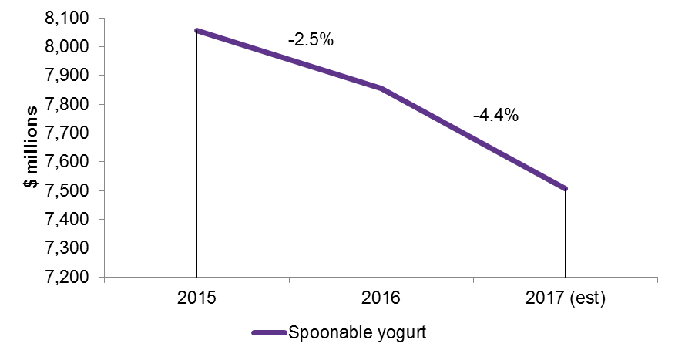
Spoonable yogurt declines 6.8% from 2015 – 2017
While the overall yogurt and yogurt drinks category declined at a more modest rate, 4% since 2016, spoonable yogurts as an individual segment took a larger hit. Up and coming formats such as non-dairy and new international styles create a diverse and competitive field driving trial, yet not enough to sustain the category. The powerful growth of the yogurt drinks may have contributed to the decline in traditional spoonable sales as consumers move their dollars to enter the segment that thrives on convenience and portability. As novelty of Greek yogurt wore off and sales of traditional types took a hit, overall decline was inevitable.
Total US retail sales and forecast of yogurt and yogurt drinks/kefir, by segment, at current prices, 2015-17
Source: based on Information Resources Inc., InfoScan Reviews; US Census Bureau, Economic Census/Mintel

Slide 4
Newer yogurt segments and flavors have a lower perception of health
Yogurt perceptions, May 2017
“Which of the following do you associate with each type of yogurt?”
New products like drinkable and dessert flavored yogurts are growing in popularity and shelf space; however, knowledge and perception of nutritional value is lacking. Spoonable traditional and Greek yogurts are the most familiar among the consumers, resulting in an increased relation to certain attributes, consumption occasions, and reasons to eat such as high protein, digestive health, and good for breakfast. Yogurt drinks do stand out, though, as having a higher association to kids and an apparent benefit of being portable. While these are unique reasons to buy, lacking awareness of nutritional benefits may impact growth.
Base: 2,000 internet users aged 18+ Source: Lightspeed/Mintel

Slide 5
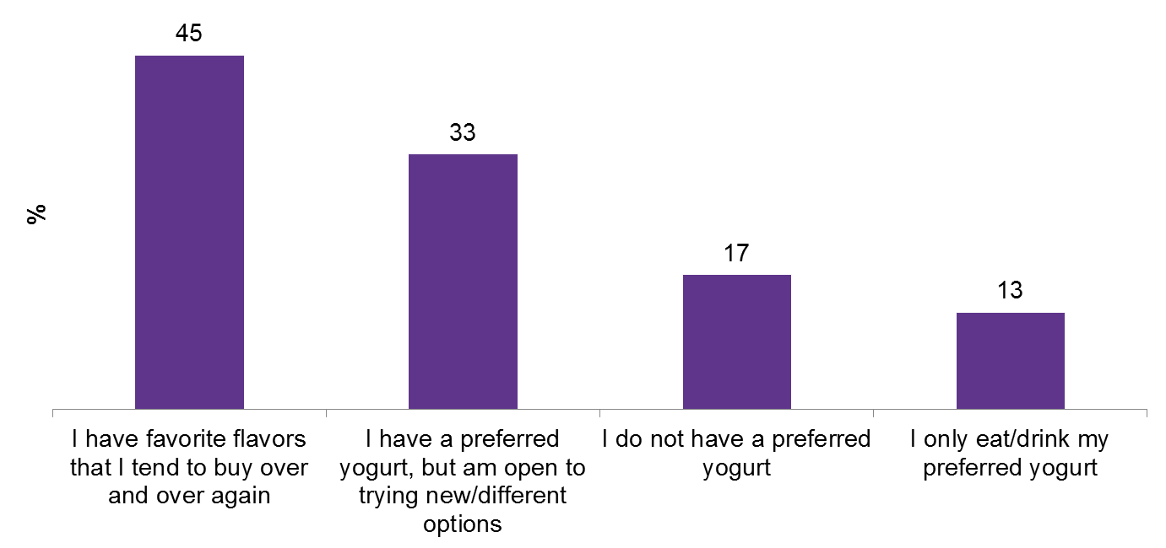
Purchase often based on habitual preferences
While innovation keeps novelty and buzz around the category alive, a large portion of consumers have a preferred yogurt and continue to purchase based off their existing preferences. As variety in style and flavor options continues to spread, consumers may reach to products or brands they know and love to avoid feeling overwhelmed. These habits challenge brands trying to convert loyalists, break into the market or get a product extension in the hands of consumers.
Purchase/consumption behaviors, May 2017
“Which of the following statements about yogurt do you agree with? Please select ALL that apply.”
Base: 1,439 internet users aged 18+ who have purchased yogurt in the past 3 months Source: Lightspeed/Mintel

Slide 6
Added sugars remain a concern
As healthy eating trends continue to gain momentum, more food and drink products have been under scrutiny to be transparent in added sugar content, which, barring FDA changes, will be mandatory by law soon. Greek yogurt and fruit flavored are the most commonly bought yogurt types, driven by health and nutritional aspects such as protein and probiotics. While not all consumers outwardly express to seek out low sugar content or natural sweeteners, as product labels begin to show added sugars and consumer awareness increases, this can continue to hurt the traditional types of yogurt who already are seeing decline.
Attitudes toward yogurt and yogurt drinks, by age, May 2017
“Which of the following statements about yogurt do you agree with? Please select ALL that apply.”
Base: 1,439 internet users aged 18+ who have purchased yogurt in the past 3 months Source: Lightspeed/Mintel

Slide 7
The Opportunities
Yogurt drinks and kefir expected to continue strong growth and drive the category
Innovative textures and flavors can expand the market
Consumers seek protein, probiotics and low sugar

Slide 8
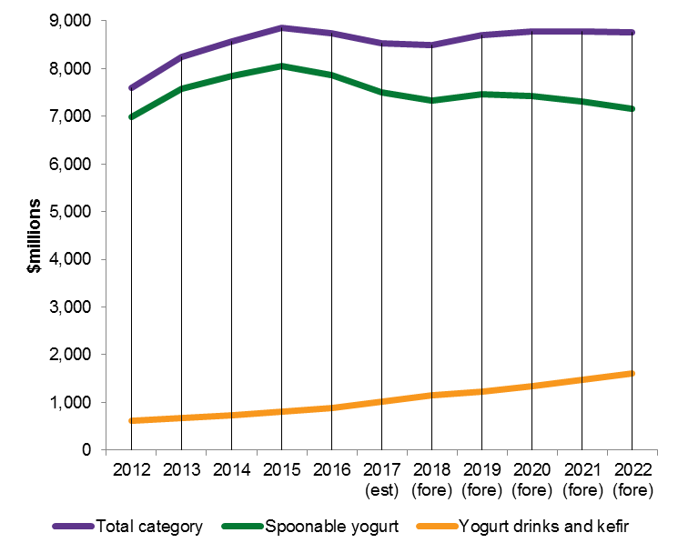
Yogurt drinks and kefir expected to continue strong growth and drive the category
Despite drop offs within the spoonable yogurt segment, yogurt drinks are expected to climb 58% over the next five years. Currently only 13% of adults say they have bought a yogurt drink in the past three months. However, as key players such as Chobani and Dannon Oikos continue to expand into this segment, as well as introduction of private label and smaller named brands, consumer interest and trial are expected to continue to rise.
Total US retail sales and forecast of yogurt and yogurt drinks/kefir, by segment, at current prices, 2012-22
Source: based on Information Resources Inc., InfoScan Reviews; US Census Bureau, Economic Census/Mintel

Slide 9
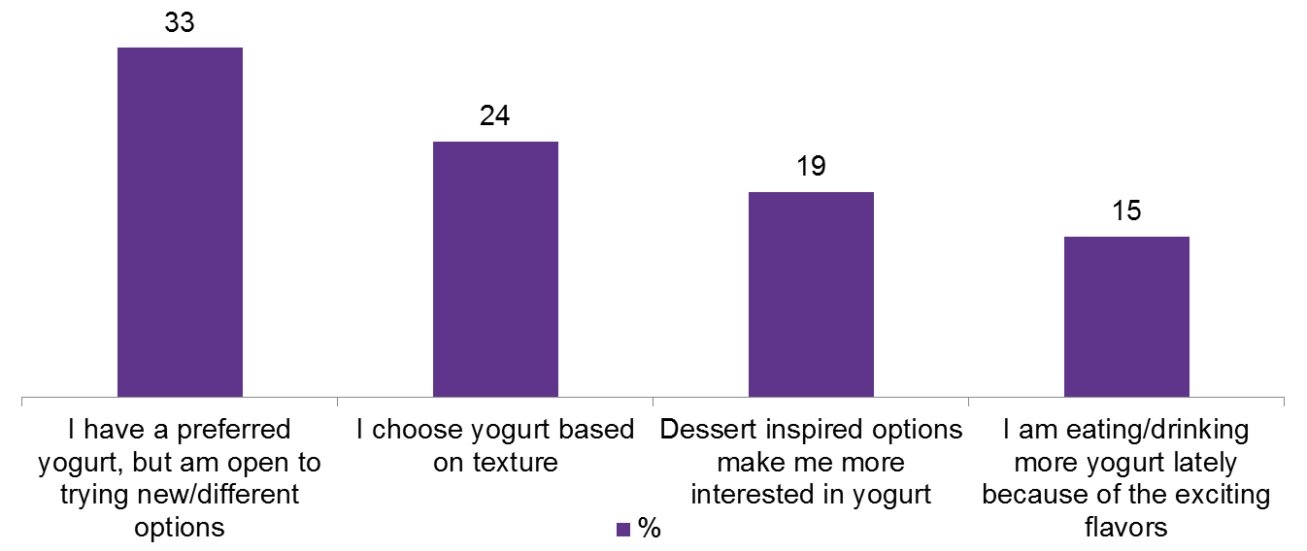
Innovative textures and flavors can expand the market
Consumers prefer fruit flavored yogurts to other innovative types; however, new textures and flavors can drive additional purchases and new customer trial. Yogurts with intriguing fruit or indulgent flavors may draw consumers into the market, appealing to new consumption occasions and reasons to buy. Additionally, newer international types of yogurt especially can appeal to these consumers. When the thickness of Greek yogurt becomes the norm, even thicker Icelandic or rich and creamy Australian styles may appeal to them as a nice change in routine. Consumers are also fond of yogurt with mix-ins, which change up texture and flavor simultaneously, especially attractive to those who aren’t as adventurous in trial of new yogurt types in the market.
Purchase/consumption behaviors, May 2017
“Which of the following statements about yogurt do you agree with? Please select all that apply.”
Base: 1,439 internet users aged 18+ who have purchased yogurt in the past 3 months
Source: Lightspeed/Mintel

Slide 10
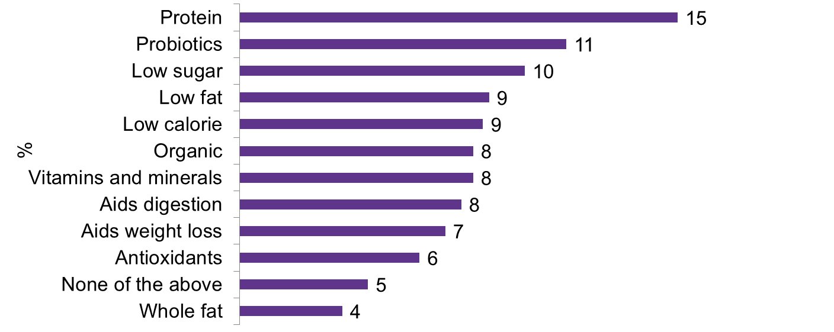
Consumers still seek protein first, also yogurts with probiotics and low sugar
Protein is the most desired attribute in yogurt, proving that although sales of Greek yogurt have leveled off, consumer preference remains steadfast. As the market becomes inundated with products with high protein claims, yogurt can also boast other nutritional benefits that consumers would find appealing such as containing probiotics or being low in sugar: 31% of consumers say they seek out yogurts low in sugar, and 20% with natural sweeteners. Promoting a wider range of benefits can appeal to a consumer bombarded with the same claim across products.
Ideal yogurt/yogurt drink creation, Yogurt attributes, May 2017
“If you could create your own ideal yogurt or yogurt drink, what would it be like? Please select one in each section to create your ideal product.”
Base: 1,439 internet users aged 18+ who have purchased yogurt in the past 3 months Source: Lightspeed/Mintel

Slide 11
What it Means
Spoonable yogurts are making way for innovative types, such as yogurt drinks, to rise. Health and nutritional aspects are the main reason people consume; however, with a lack of education and widespread familiarity, new yogurt products struggle to make a healthful impression. Classic fruit flavors remain the most preferred at the end of the day, but international varieties and novel flavor innovations (like dessert-inspired) keep category excitement alive as well as position the category as good for various consumption occasions.

Slide 12

Megan Hambleton
Drink Analyst
mhambleton@mintel.com
mintel.com

